Slide 1

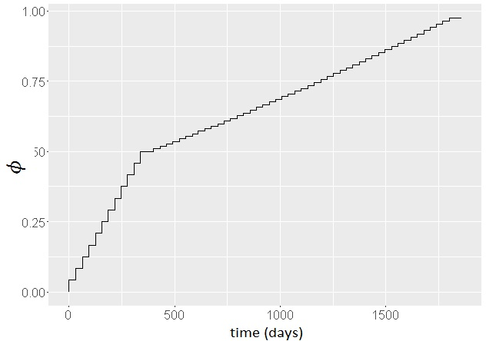
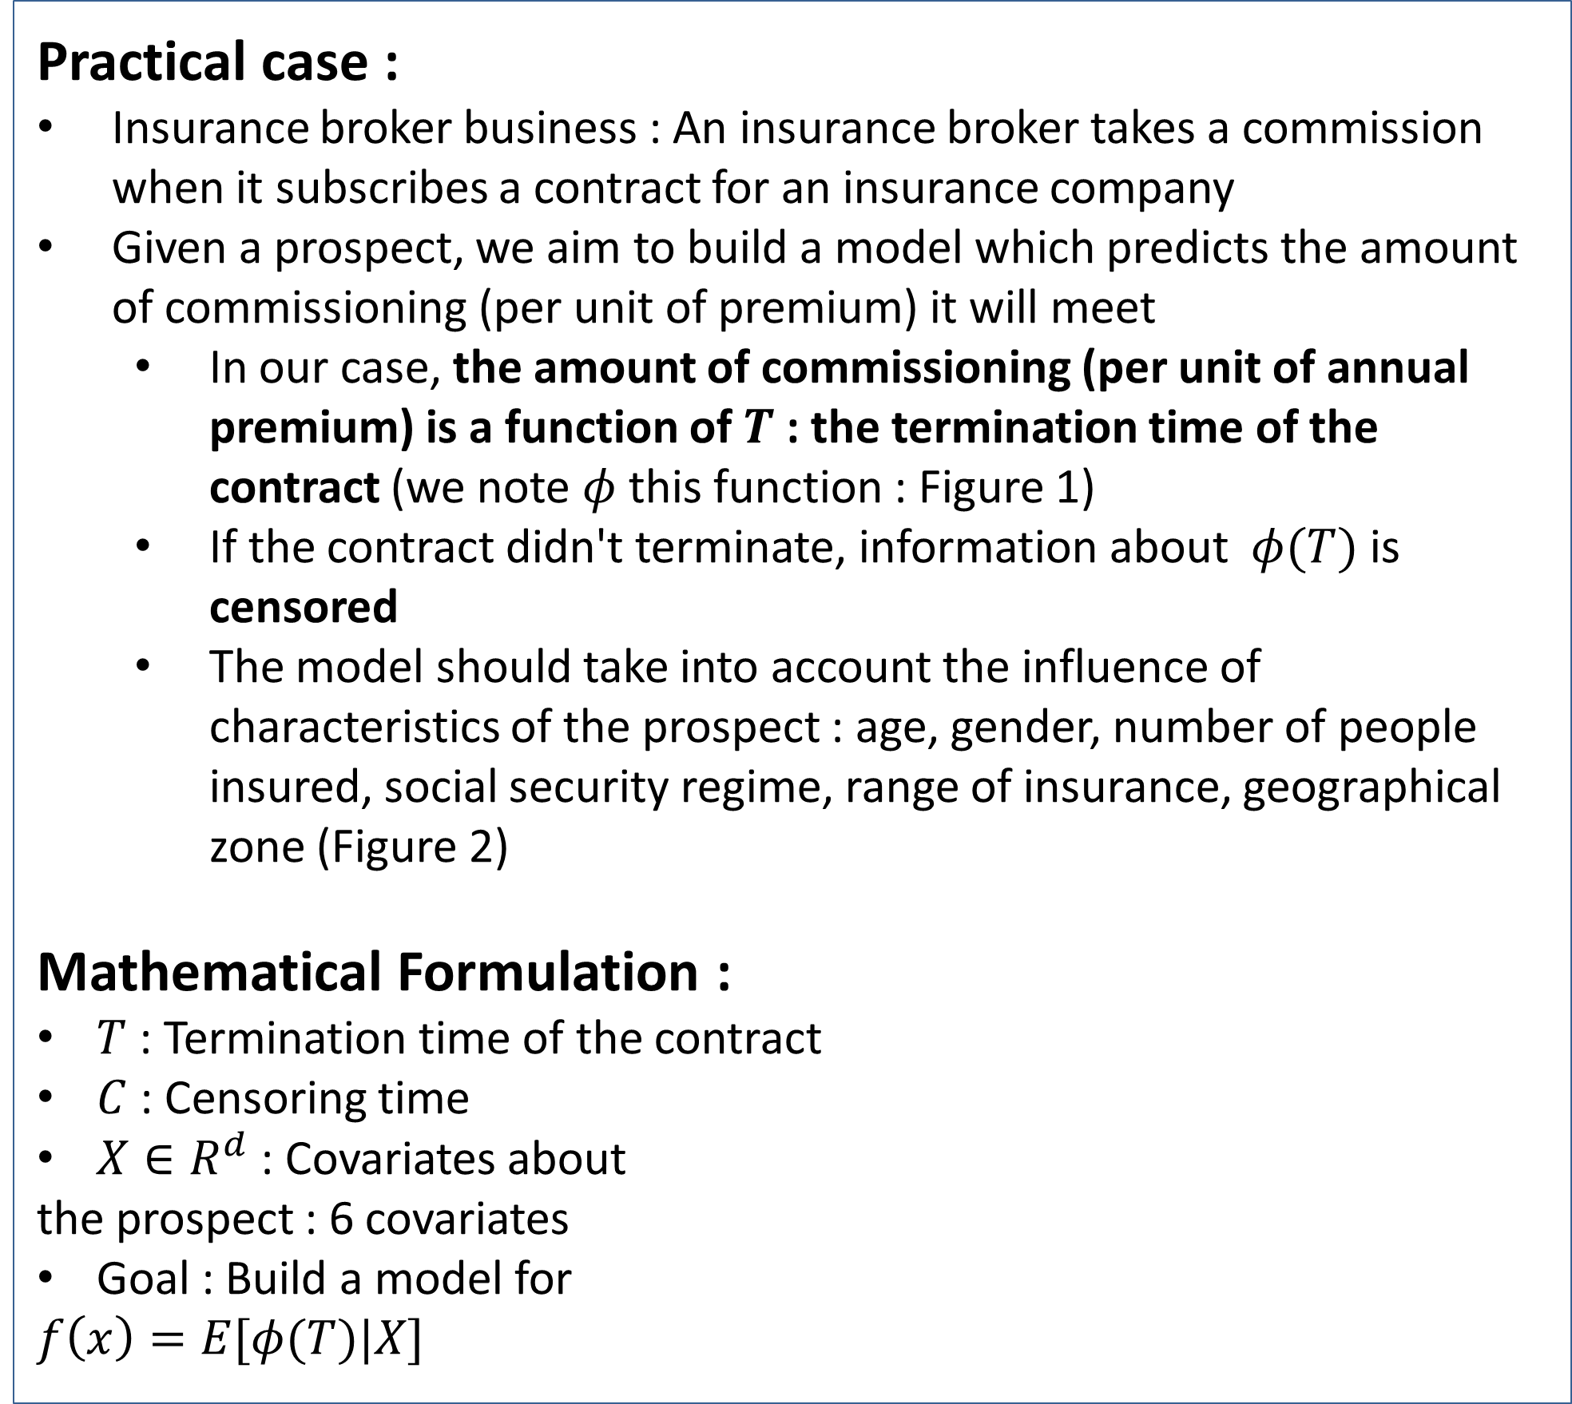
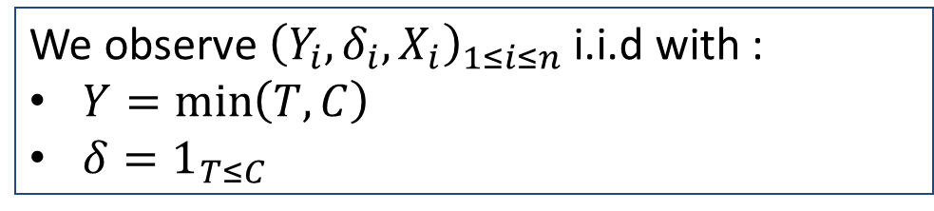
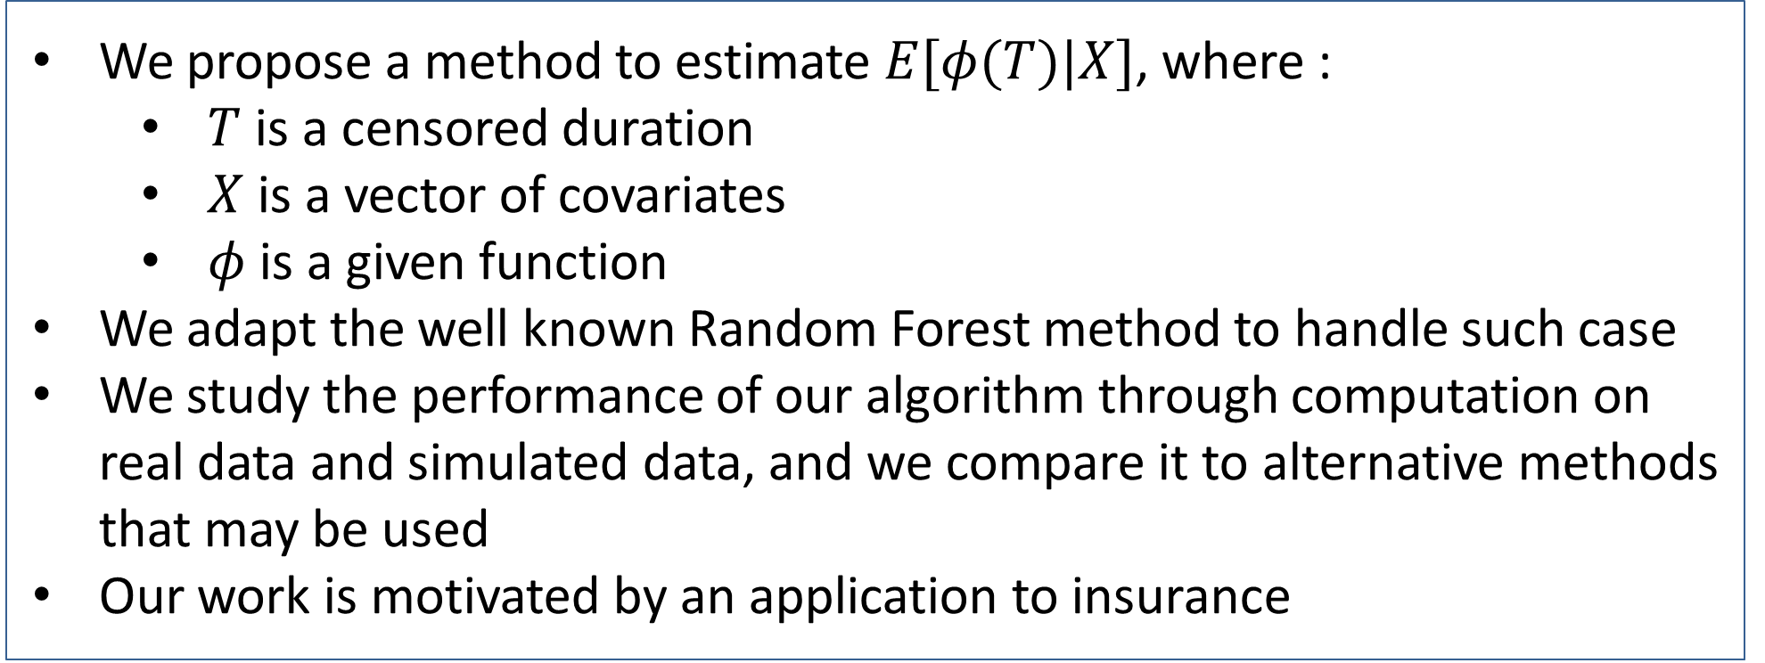
Random Forest for Regression of a Censored Variable
REPLACE THIS BOX WITH YOUR ORGANIZATION’S
HIGH RESOLUTION LOGO
Yohann Le Faou (yohann.lefaou@forsides.fr)
Forsides & Université Pierre et Marie Curie (Paris 6)
Contribution
Methods and Materials
We propose a method to estimate $E[φ(T)|X]$, where :
$T$ is a censored duration
$X$ is a vector of covariates
$φ$ is a given function
We adapt the well known Random Forest method to handle such case
We study the performance of our algorithm through computation on real data and simulated data, and we compare it to alternative methods that may be used
Our work is motivated by an application to insurance
Click here to insert your Methods and Materials text. Type it in or copy and paste from your Word document or other source.
This text box will automatically re-size to your text. To turn off that feature, right click inside this box and go to Format Shape, Text Box, Autofit, and select the “Do Not Autofit” radio button.
To change the font style of this text box: Click on the border once to highlight the entire text box, then select a different font or font size that suits you. This text is Calibri 30pt and is easily read up to 4 feet away on an A0 poster.
Zoom out to 100% to preview what this will look like on your printed poster.
Introduction
Chart 1. Label in 24pt Calibri.
Practical case :
Insurance broker business : An insurance broker takes a commission when it subscribes a contract for an insurance company
Given a prospect, we aim to build a model which predicts the amount of commissioning (per unit of premium) it will meet
In our case, the amount of commissioning (per unit of annual premium) is a function of $T$ : the termination time of the contract (we note $φ$ this function : Figure 1)
If the contract didn't terminate, information about $φ(T)$ is censored
The model should take into account the influence of characteristics of the prospect : age, gender, number of people insured, social security regime, range of insurance, geographical zone (Figure 2)
Mathematical Formulation :
$T$ : Termination time of the contract
$C$ : Censoring time
$X∈R^{d}$ : Covariates about
the prospect : 6 covariates
Goal : Build a model for
$$f\left(x\right)=E[φ(T)|X]$$
Results
Discussion
Click here to insert your Results text. Type it in or copy and paste from your Word document or other source.
This text box will automatically re-size to your text. To turn off that feature, right click inside this box and go to Format Shape, Text Box, Autofit, and select the “Do Not Autofit” radio button.
To change the font style of this text box: Click on the border once to highlight the entire text box, then select a different font or font size that suits you. This text is Calibri 30pt and is easily read up to 4 feet away on an A0 poster.
Zoom out to 100% to preview what this will look like on your printed poster.
Speaking of Results, yours will look better if you remember to run a spell-check on your poster! After you’ve added your content click on Review, Spelling, or press F7.
Click here to insert your Discussion text. Type it in or copy and paste from your Word document or other source.
This text box will automatically re-size to your text. To turn off that feature, right click inside this box and go to Format Shape, Text Box, Autofit, and select the “Do Not Autofit” radio button.
To change the font style of this text box: Click on the border once to highlight the entire text box, then select a different font or font size that suits you. This text is Calibri 30pt and is easily read up to 4 feet away on an A0 poster.
Zoom out to 100% to preview what this will look like on your printed poster.
Observations
Conclusions
We observe ${\left(Y_{i},δ_{i},X_{i}\right)}_{1≤i≤n}$ i.i.d with :
$Y=\min\left(T,C\right)$
$δ=1_{T≤C}$
Click here to insert your Conclusions text. Type it in or copy and paste from your Word document or other source.
This text box will automatically re-size to your text. To turn off that feature, right click inside this box and go to Format Shape, Text Box, Autofit, and select the “Do Not Autofit” radio button.
To change the font style of this text box: Click on the border once to highlight the entire text box, then select a different font or font size that suits you. This text is Calibri 30pt and is easily read up to 4 feet away on an A0 poster.
Zoom out to 100% to preview what this will look like on your printed poster.
Table 1. Label in 24pt Calibri.
 | Heading | Heading | Heading
Item | 800 | 790 | 4001
Item | 356 | 856 | 290
Item | 228 | 134 | 238
Item | 954 | 875 | 976
Item | 324 | 325 | 301
Item | 199 | 137 | 186
Figure 1. Label in 24pt Calibri.
References
Figure 2. Label in 24pt Calibri.

